Slide 1

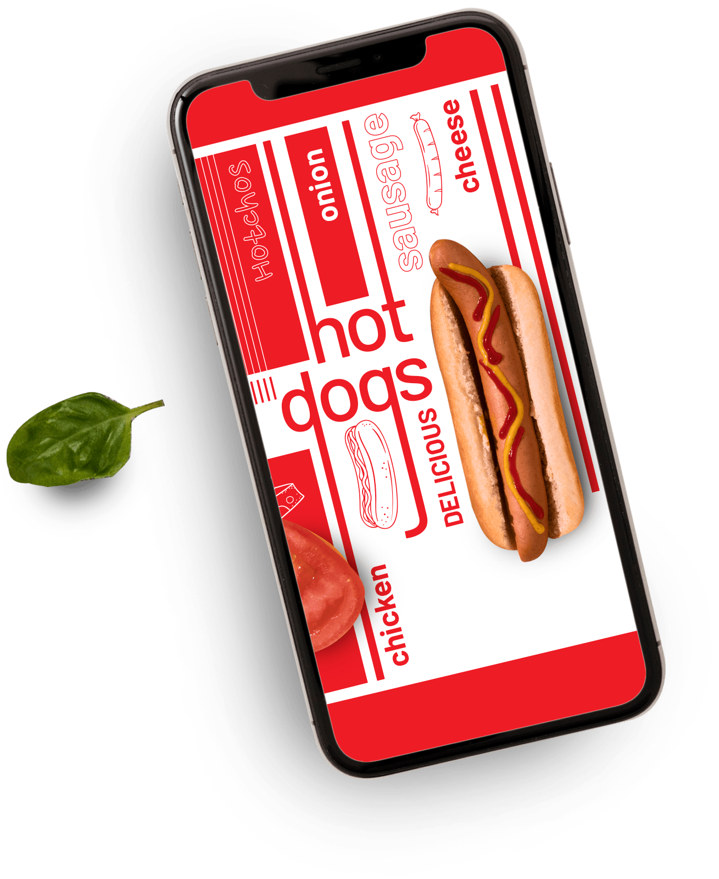





Zomato Expansion
- By Sahazadi Khatun
Home Delivery

Slide 2
Problem Statement
Zomato has appointed you as a data analyst to assist in its expansion strategy. Your task is to analyze the current dataset and suggest new locations (countries, states, cities) where opening restaurants would be strategically beneficial. The management is particularly interested in understanding market gaps, customer preferences, pricing strategies, and the competitive landscape in various regions. Your insights, supported by Excel dashboards, visualizations, and metrics, will form the basis for Zomato's decision-making process in restaurant expansion.

Slide 3
Data Overview
Restaurant ID: A unique identifier assigned to each restaurant.
Restaurant Name: The name or brand under which the restaurant operates.
CountryCode: Numerical code representing the country in which the restaurant is located.
City: The specific city where the restaurant is situated.
Address: The detailed physical address of the restaurant.
Locality: The neighbourhood or area within the city where the restaurant is found.
Locality Verbose: A more detailed description of the locality, often including nearby landmarks or zones.
Longitude: The geographic longitude coordinate of the restaurant’s location.
Latitude: The geographic latitude coordinate of the restaurant’s location.
Cuisines: A list of cuisines served by the restaurant (e.g., Indian, Chinese, Italian).
Currency: The type of currency accepted at the restaurant for transactions.
Has_Table_booking: Indicates whether the restaurant provides a table reservation option (Yes/No).
Has_Online_delivery: Specifies if the restaurant offers online delivery services (Yes/No).
Is_delivering_now: Shows whether the restaurant is currently accepting delivery orders (Yes/No).
Switch_to_order_menu: Indicates if users can switch directly to the online order menu (Yes/No).
Price_range: A numeric category (typically from 1 to 4) indicating the pricing tier of the restaurant.
Votes: The total number of customer votes or ratings the restaurant has received.
Average_Cost_for_two: The average expenditure for two people dining together at the restaurant.
Rating: The average customer rating based on reviews and feedback (usually on a scale of 1 to 5).
Datekey_opening: The date on which the restaurant was officially opened.

Slide 4
Number of Restaurants by Country
Insight:
This bar chart displays the number of restaurants listed in each country. India leads overwhelmingly with 8,652 restaurants, followed by the United States with 434. Other countries like Canada, Singapore, and Qatar have significantly fewer listings, indicating potential opportunities for expansion in these markets.

Slide 5
Has Online Delivery
Insight:
This pie chart highlights the number of restaurants have Online Delivery or not.
A majority of restaurants lack online delivery options.
Only 26% offer online delivery. This indicates a potential market gap—enhancing this service could improve customer convenience and attract more diners.

Slide 6
Has Table Booking
Insight:
This pie chart highlights the number of restaurants have Table Booking or not.
A majority of restaurants lack table booking options.
Just 12% offer table booking. This indicates a potential market gap—enhancing this service could improve customer convenience and attract more diners.

Slide 7
Restaurants Opened Per Year
Insight:
This line chart shows the number of restaurants opened each year from 2010 to 2018. The trend reveals steady growth over time, starting from 1,022 in 2012 and reaching 1,102 by 2018, indicating consistent expansion in the restaurant industry.

Slide 8
Country-wise Average of Votes
Insight:
This bar chart highlights the average number of votes received by restaurants in each country. Indonesia leads significantly with an average of 772.1 votes, followed by the United Arab Emirates and Turkey. In contrast, countries like Brazil and Singapore show much lower engagement, indicating potential differences in customer review culture or platform usage.

Slide 9
Top 10 Cuisines
Insight:
This bar chart showcases the most popular cuisines based on frequency. North Indian cuisine tops the list by a wide margin with 936 entries, followed by Chinese (511) and Fast Food (354). This highlights a strong preference for traditional and widely accepted food categories among consumers.

Slide 10
Number of Cities Covered per Country
Insight:
This horizontal bar chart illustrates how many cities are represented in each country. India leads with 43 cities, followed by the United States with 35, and Australia with 23. Countries like Qatar, Sri Lanka, and Singapore are at the bottom with just 1 city each, highlighting possible areas for future data expansion or market entry.

Slide 11
Country-wise Average of Ratings
Insight:
This bar chart presents the average customer ratings for restaurants across different countries. The Philippines ranks the highest with an impressive 4.5 average rating, followed closely by Turkey, Indonesia, and New Zealand at 4.3. In contrast, India records the lowest average at 2.8, highlighting variations in customer satisfaction or rating behavior across regions.

Slide 12
Country-wise Average Cost for Two (in INR)
Insight:
This bar chart presents the average dining cost for two people (converted to Indian Rupees) across different countries. Singapore stands out with the highest cost at ₹13,491, followed by the Philippines (₹9,802) and Qatar (₹5,314). On the other end, Turkey (₹382) and India (₹623) offer the most affordable dining options, highlighting significant variation in restaurant pricing globally.

Slide 13
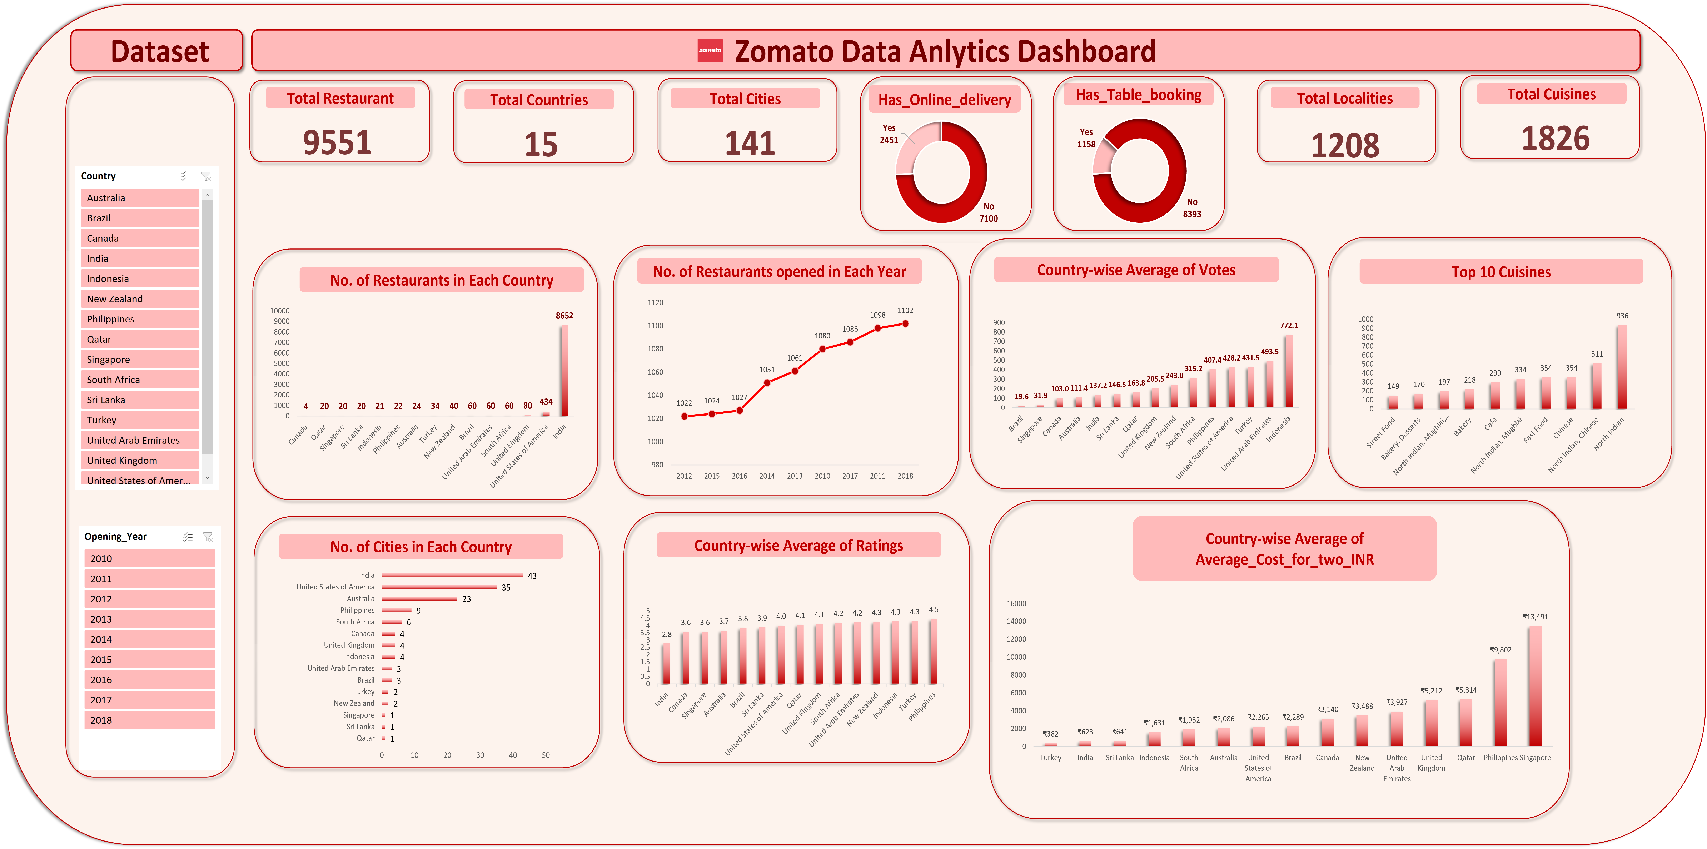
DASHBOARD

Slide 14
Recommendation
Strategic Recommendations:
Expand in low-competition, high-rating countries like Indonesia, Qatar, and Turkey.
Focus on cities with high votes but fewer restaurants.
Use mid-range pricing (Price Range 2–3) for broad appeal.
Promote multi-cuisine menus to boost ratings.
Enable delivery & booking to improve customer experience.
Adapt pricing by region—premium in costly areas, value in sensitive ones.
Target weak competitors with better service and marketing.

Slide 15
Conclusion
Above charts are created in my dashboard after Data Cleaning & Preparation, Data Transformation and Strategic Evaluation.
This dashboard provides a comprehensive view of restaurant trends and performance across countries and over time. With the help of interactive slicers for both Year and Country, users can dynamically explore and filter insights to support strategic decision-making.
Together, these slicers enable targeted insights — whether identifying high-potential markets for expansion, understanding pricing dynamics, or analyzing customer satisfaction — making the dashboard a powerful tool for strategic restaurant planning.
This dashboard project offers actionable insights for Zomato’s strategic expansion by analyzing restaurant data across multiple countries and cities. Through detailed visualizations and pivot-based analysis, we identified high-potential markets with low competition, popular cuisines, cost-effective ideal pricing strategies, and customer service preferences. Overall, the findings support data-driven decisions for restaurant growth, customer satisfaction, and market entry optimization.

Slide 16

Thank You

